Slide 1
Build-Your-Own AI AgentFramework:
A Web-Based Agentic Workflow System
Name:Utkarsha Ramesh Belure , Yash Vijay Patil , Madhura Shivram Gawade
Branch: E&TC engineering
Year Second Year of Engineering
College: PCET’S NMIET, Talegaon Dabhade,Pune
Internship / Certification Program: INTEL Unnati Industrial Training 2025 Program

Slide 2
Problem Statement:
The objective of this project is to build an AI Agent Framework that can orchestrate agentic
workflows from user input to output without using existing agent frameworks such as CrewAI,
AutoGen, or n8n.
The framework should:
Support task flow execution
Allow modular agents
Provide observability and execution control
Be deployable as a web application

Slide 3
Motivation
Modern AI systems are moving from single responses to agent-based workflows
Existing agent frameworks are complex and abstract for beginners
There is a need for a simple, understandable AI agent framework
This project focuses on:
Learning agent design
Workflow orchestration
Web-based execution

Slide 4
HIGH-LEVEL ARCHITECTURE
System Architecture
The system follows a modular pipeline architecture:
User → Web UI → Flask Backend
↓
Planner Agent
↓
Executor Agent
↓
Reviewer Agent
↓
Output

Slide 5
Description:
User interacts through a web interface
Flask backend orchestrates agent execution
Each agent performs a specific responsibility

Slide 6
AGENT DESIGN
Agent Components
Planner Agent
  Analyzes the user task
  Breaks it into step-by-step plan
Executor Agent
  Executes the planned steps
  Generates a detailed and structured answer
Reviewer Agent
  Reviews the execution result
  Produces a concise summary and validation
Each agent is modular and independently extensible.

Slide 7
WORKFLOW EXECUTION
Task Execution Flow:
1)User enters a task through the UI
2)Planner Agent generates a step-wise plan
3)Executor Agent processes each step
4)Reviewer Agent validates and summarizes output
5) Final response is displayed to the user
This forms an agentic workflow pipeline.

Slide 8
CORE FEATURES:
Key Features Implemented
Two-page web interface (Landing + Task Page)
Modular agent architecture
Step-by-step task planning
Detailed execution responses
Review and summary output
Cloud deployment with public access

Slide 9
TECHNOLOGIES USED:
Tech Stack
Programming Language: Python
Backend Framework: Flask
Frontend: HTML, CSS, JavaScript
Version Control: GitHub
Deployment Platform: Render
Architecture: Agent-based Workflow Design

Slide 10
LIVE DEMO:
Live Demonstration
Public URL:https://ai-agent-framework-og.onrender.com/
Demo Steps:
Open the application
Enter a task (example: “Explain AI agents”)
Click Run
Observe:
  Plan
  Execution
  Review
The system responds with structured, step-by-step output.

Slide 11
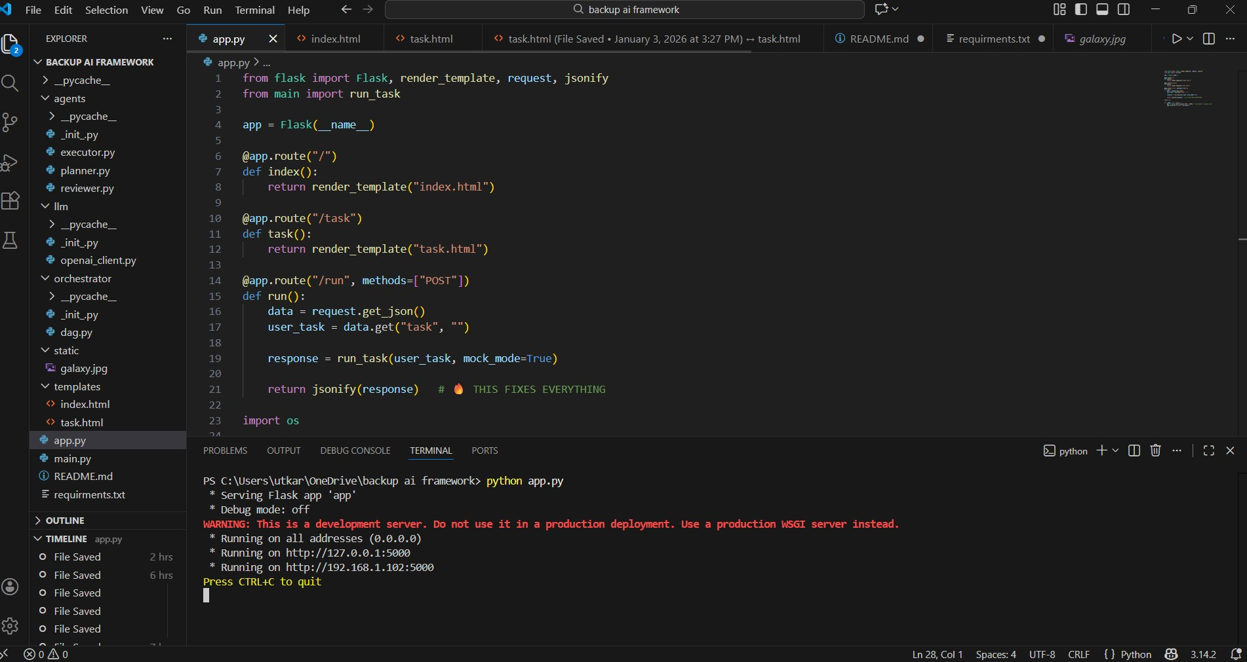

Slide 12
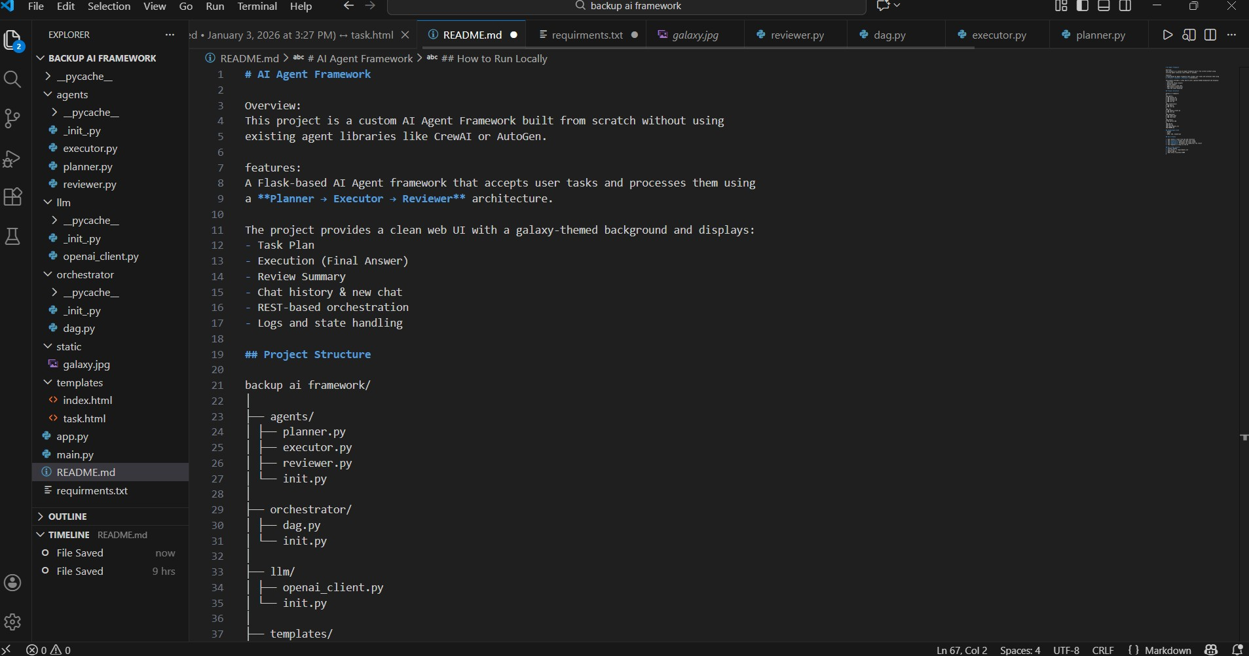

Slide 13
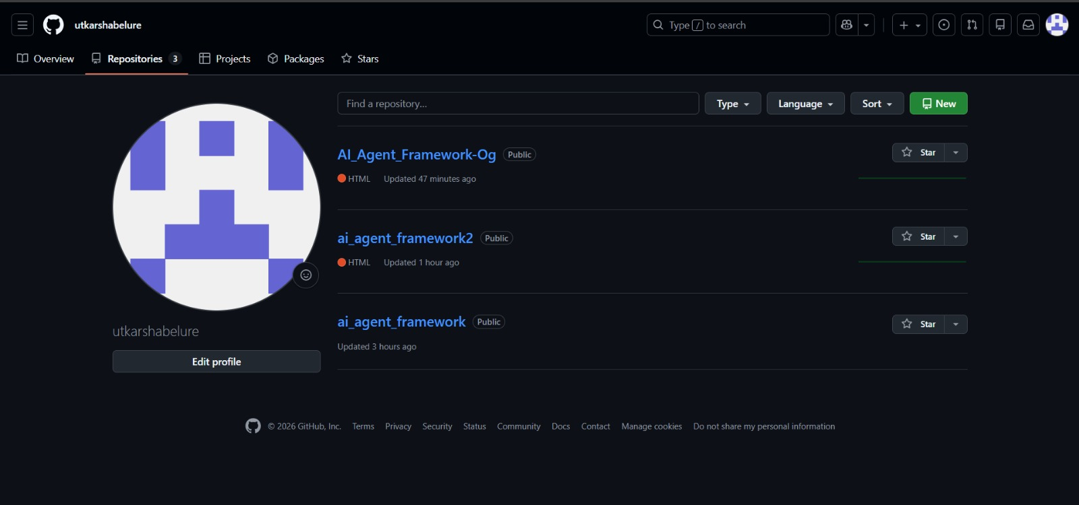
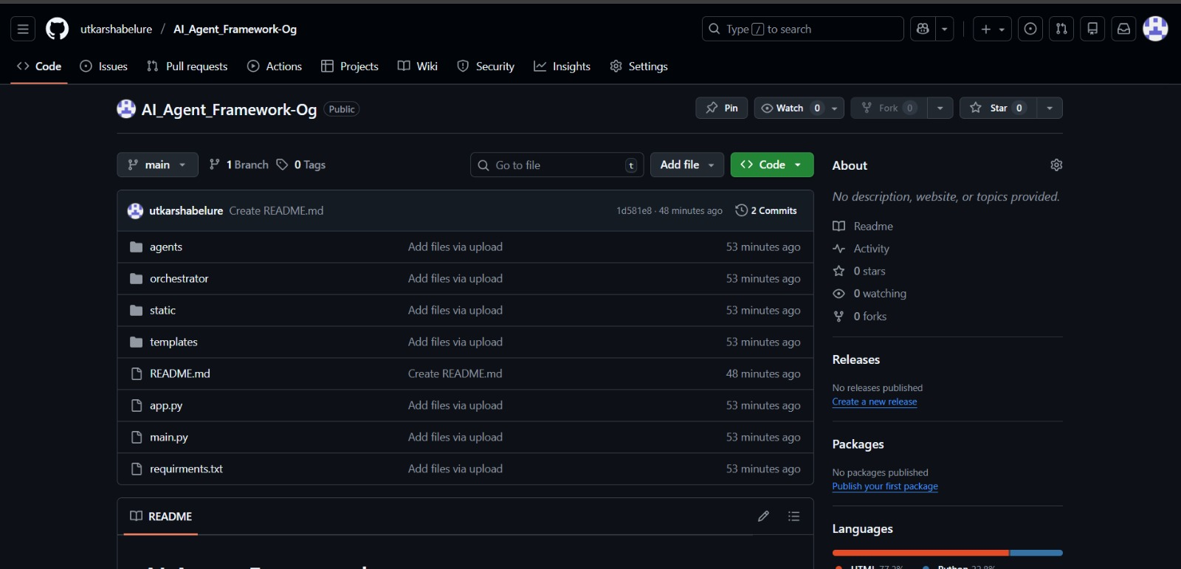

Slide 14
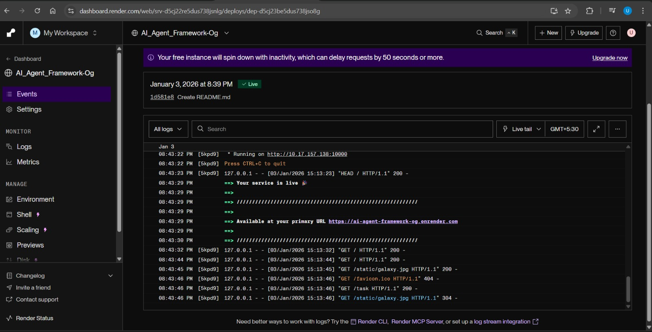
Render Deployment:

Slide 15
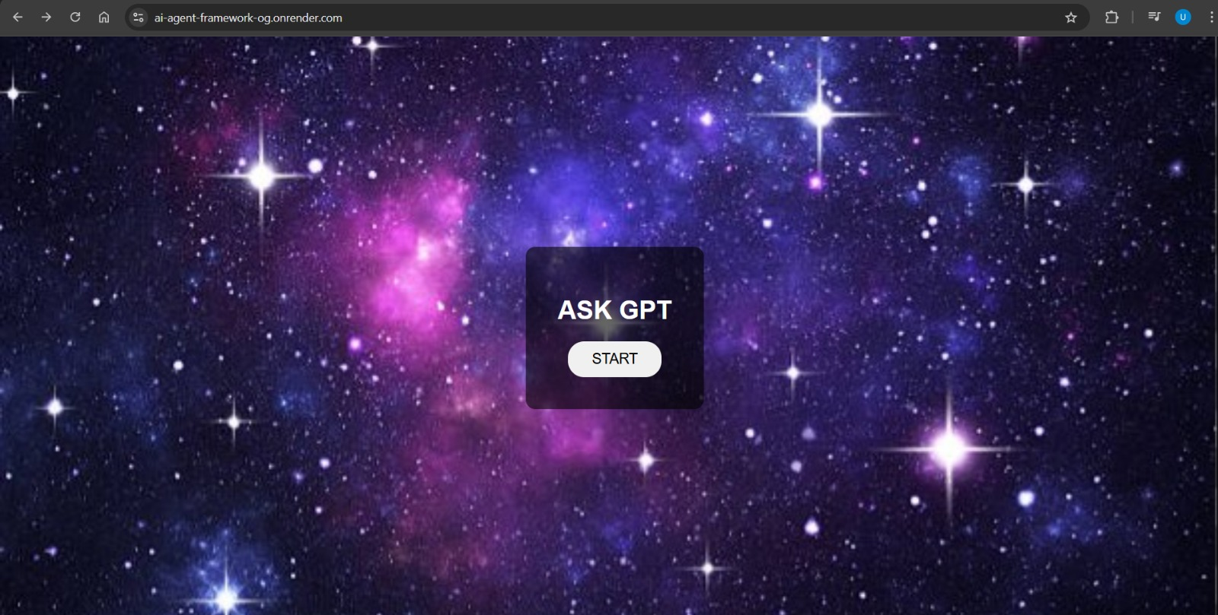
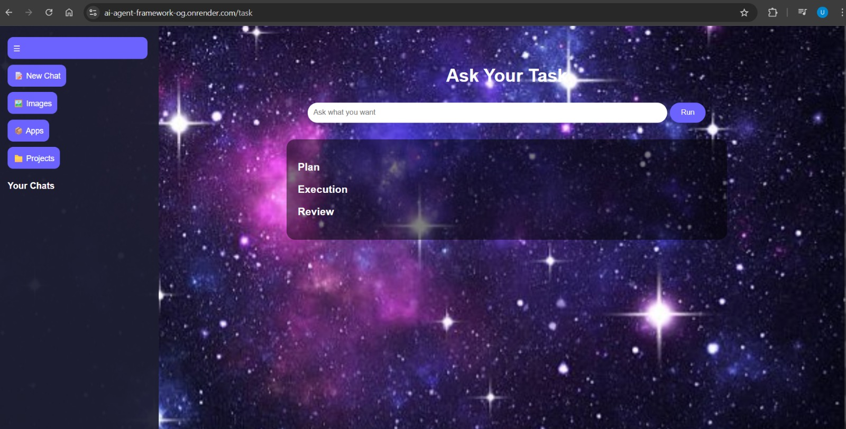
Working On Laptop: (INDEX PAGE) AND (TASK PAGE)

Slide 16
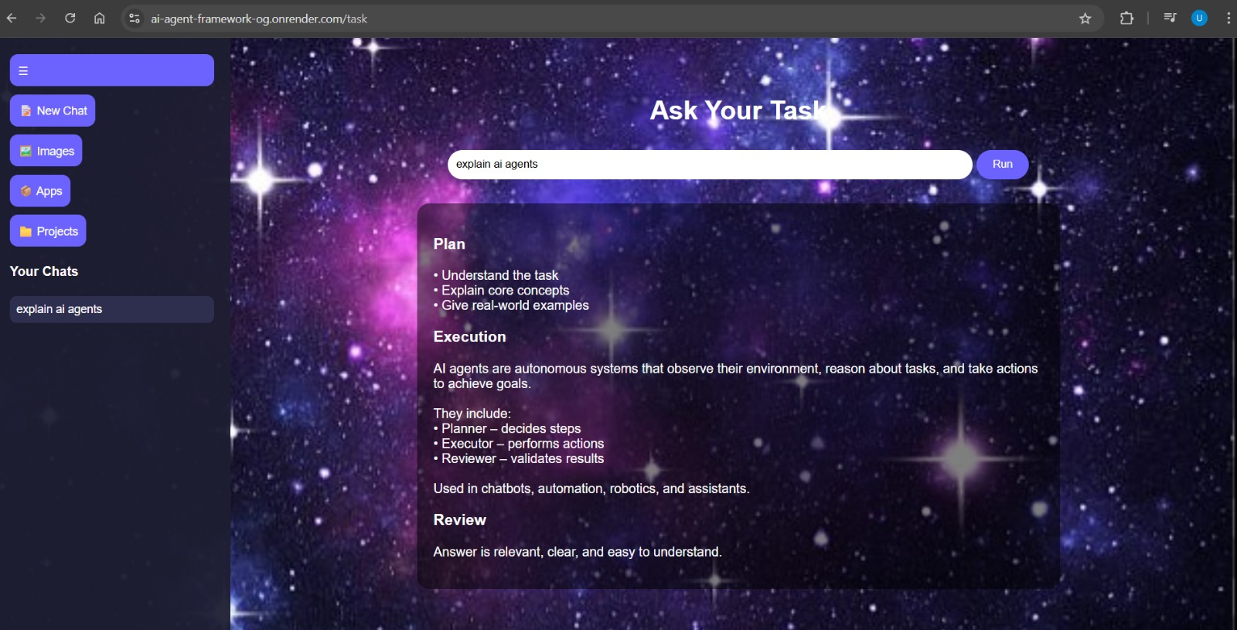
MOCK MODE:

Slide 17
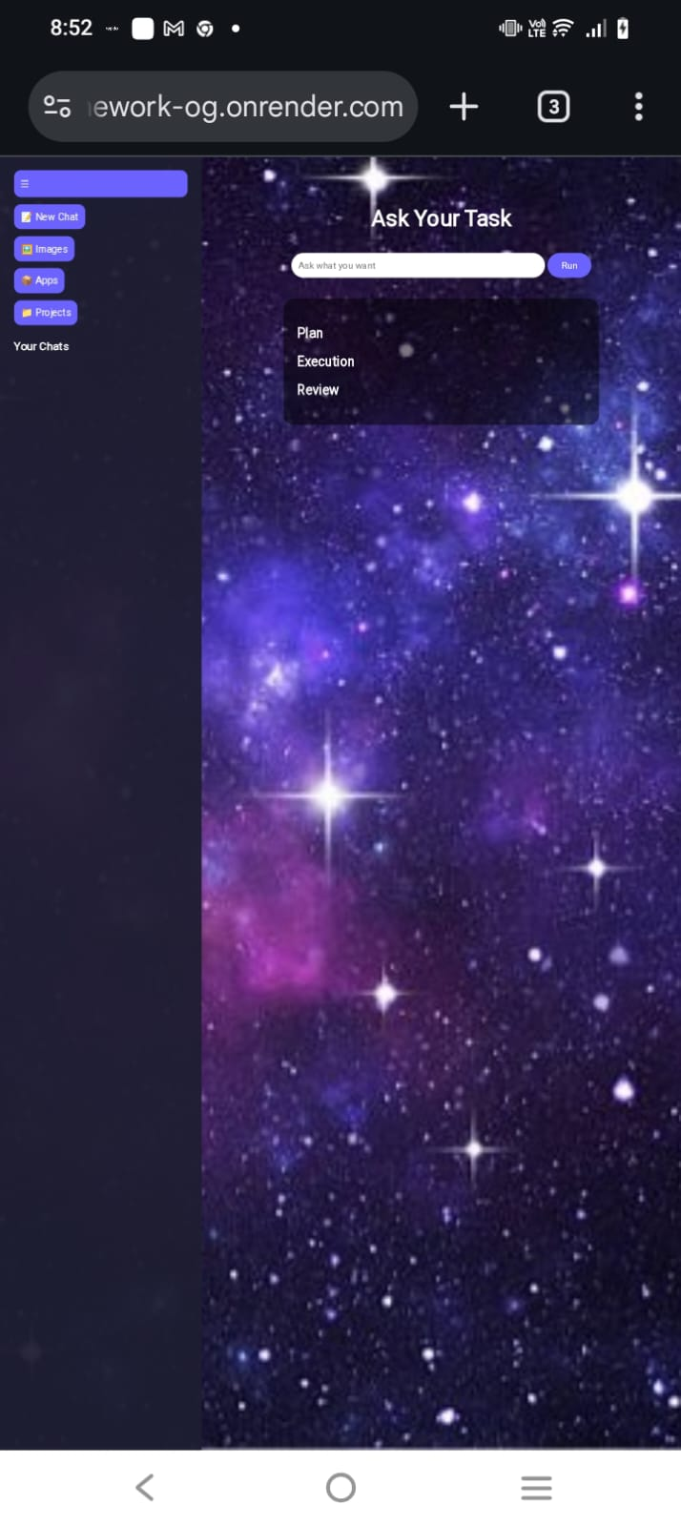
WORKING ON MOBILE:

Slide 18
Performance & Observability
The framework supports Mock Mode execution
Mock mode is used to simulate agent reasoning without paid APIs
Enables:
  Free testing
  Fast prototyping
  Reliable demos during evaluation
Agent outputs are generated deterministically for consistency
Logging is used to observe each agent’s steps

Slide 19
FUTURE SCOPE & DESIGN DECISIONS:
Apache Kafka, Airflow, and OpenVINO were intentionally not integrated in the
current version
Reason:
  Project focuses on core agentic workflow concepts
  Time-bound academic implementation
  Avoid unnecessary system overhead for a single-user workflow
  Suitable for second-year engineering level
Future Enhancements
Apache Kafka → for distributed message passing between agents
Apache Airflow → for complex DAG-based orchestration
Intel OpenVINO → for optimized ML inference
Multi-agent collaboration
Persistent memory and human-in-the-loop approvals

Slide 20
Some Crucial Points:
We Did not use OpenAI API as LLM calls are mocked to demonstrate agent orchestration logic without external dependency or billing requirements.
We have built:A Working AI Agent Framework with Planner → Executor → Reviewer using Flask + HTML + JS with mock mode architecture.

Slide 21
CONCLUSION:
Successfully designed and implemented an AI Agent Framework
Demonstrated agentic workflow orchestration
Built using simple, beginner-friendly technologies
Deployed as a public web application
Meets all project requirements and learning objectives

